Slide 1

Vault AI: AI-Assisted Secrets Management
Abdi Ibrahim - SE
Technical Demo | 2026

Slide 2
Agenda
Introduction to Vault AI
The Problem with Traditional Vault Management
The Vault AI Solution & Value Proposition
Architecture Overview
Demo Environment & Use Cases
Security Considerations
Next Steps & Q&A

Slide 3
What is Vault AI?
Modern web interface combining traditional Vault API operations with AI-assisted natural language workflows
Natural Language Queries - Ask questions in plain English instead of memorizing CLI commands
Intelligent Discovery - Find secrets across mounts without knowing exact paths
Hybrid Interface - Traditional UI + AI chat working together seamlessly

Slide 4
Why Change? The Challenge
Engineers spend days learning Vault CLI syntax and complex API patterns
Business Objective | FY26 Strategic Initiative (Exec Sponsor) | Risk Detail
E-commerce upgrade live on Feb 15th. Expected to contribute $2M in additional revenue | Cloud migration (CIO) | Eight week best case application delivery cycle time is too slow to support cloud migration and microservice delivery goals (300 apps/services released by September)
 | Application modernization (VP of Operations)
 | Improve security posture (CISO) | Leakage of secrets during provisioning creates breach risk
Path memorization, context switching, discovery difficulty, and onboarding friction slow teams down

Slide 5
Why Vault AI? The Value Proposition
70% faster secret retrieval | New engineers productive in hours, not weeks
Initiative Outcome | Current Challenges | Required Capabilities | Results
Rapid Application Delivery 300 applications released to cloud | Manual, platform dependent workflow and inspection with email and phone bottlenecks Ad hoc and inconsistent policy enforcement Long and variable cycle time Manual integration points | Terraform Self Service Infrastructure | Repository of standard modules that are made available to developers Consumed on-demand, as code
 | Inefficiencies managing different systems for secrets, and cryptographic operations across the organization | Vault Secrets Management | Single platform for secrets management and data encryption through a CLI, API, and GUI
Reduce Risk Zero secrets in plain text | Largely reactive security posture Developers have read/write access to cloud consoles Manual provisioning creates inconsistent / insecure environments | Terraform Multi-Cloud Compliance and Management | “Shift left” security posture Developers are restricted to “read-only” view Codified policies enforce security, compliance, and operational best practices. Policies are enforced against every provision to prevent breaches
Support Critical Applications | OSS is community supported (i.e. unsupported) | 24x7 Support | Supported application
AI validates paths, suggests corrections, and helps discover secrets you didn't know existed!

Slide 6
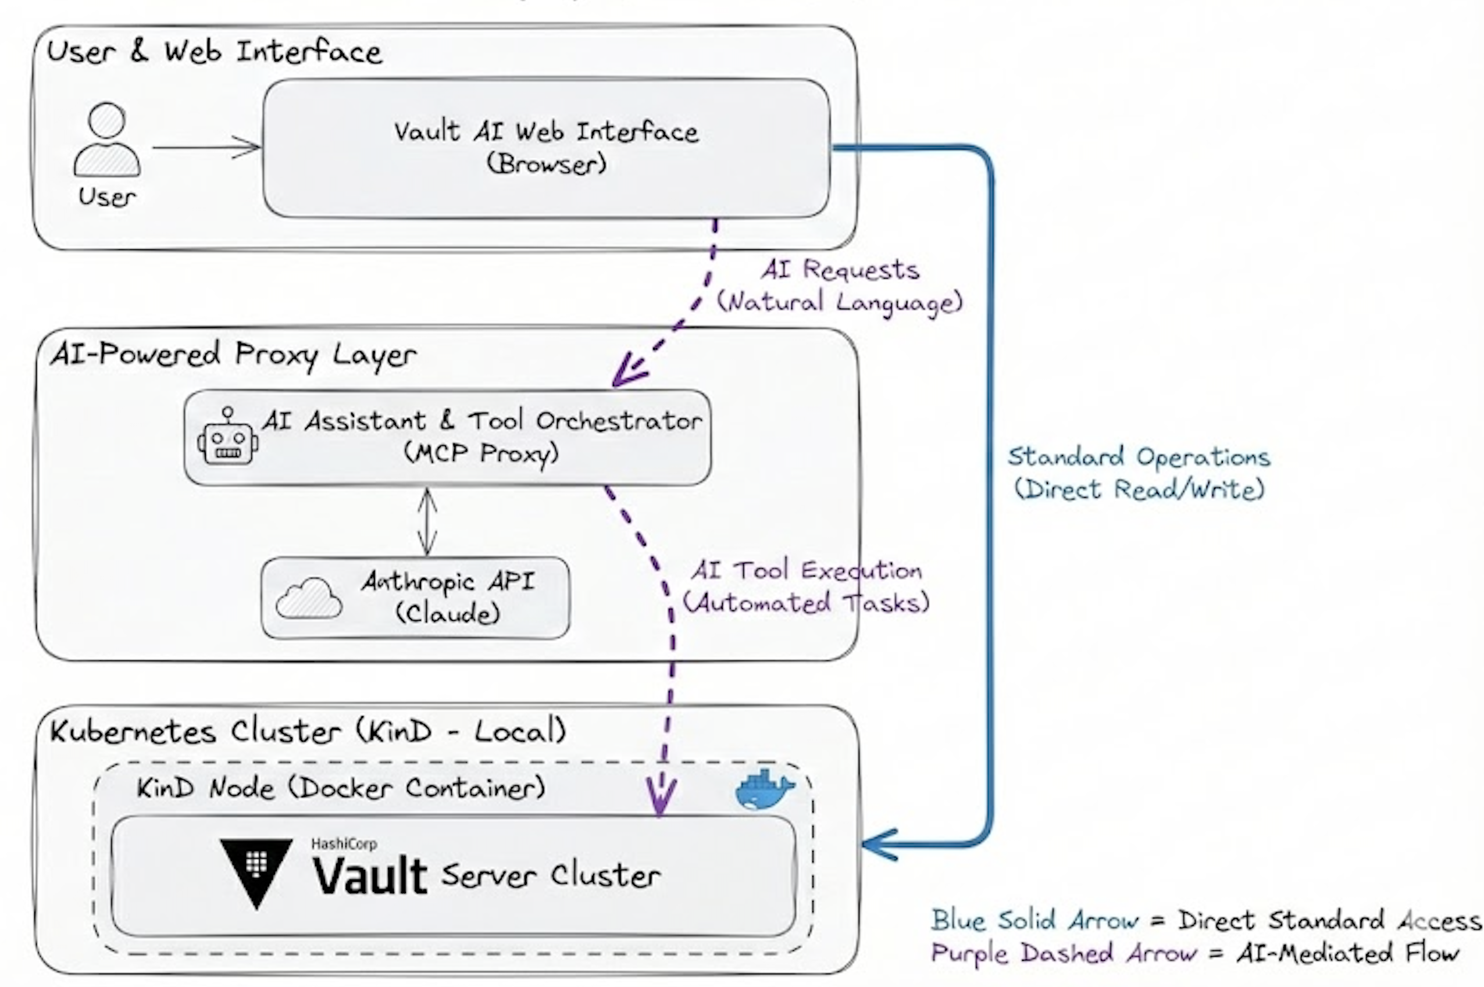
Architecture Overview
Direct HTTP API
Traditional
API Calls
Current State Data
 | Manual
Elapsed Time | 8 weeks best case
Labor Hours per request | 200
Hourly Labor Cost | $100
Annual requests | 35
Monthly Estimated Labor Cost | $58k
MCP Proxy Layer
AI-Assisted Workflows
Supported Operations
KV v2: list, read, write, delete, metadata, versions
PKI: generate CA, create roles, issue certificates, revoke
Mounts: list, enable, disable, tune engines
Coming: Transit, Database, AWS engines
User → React UI → MCP Proxy → Vault MCP Server → HashiCorp Vault

Slide 7
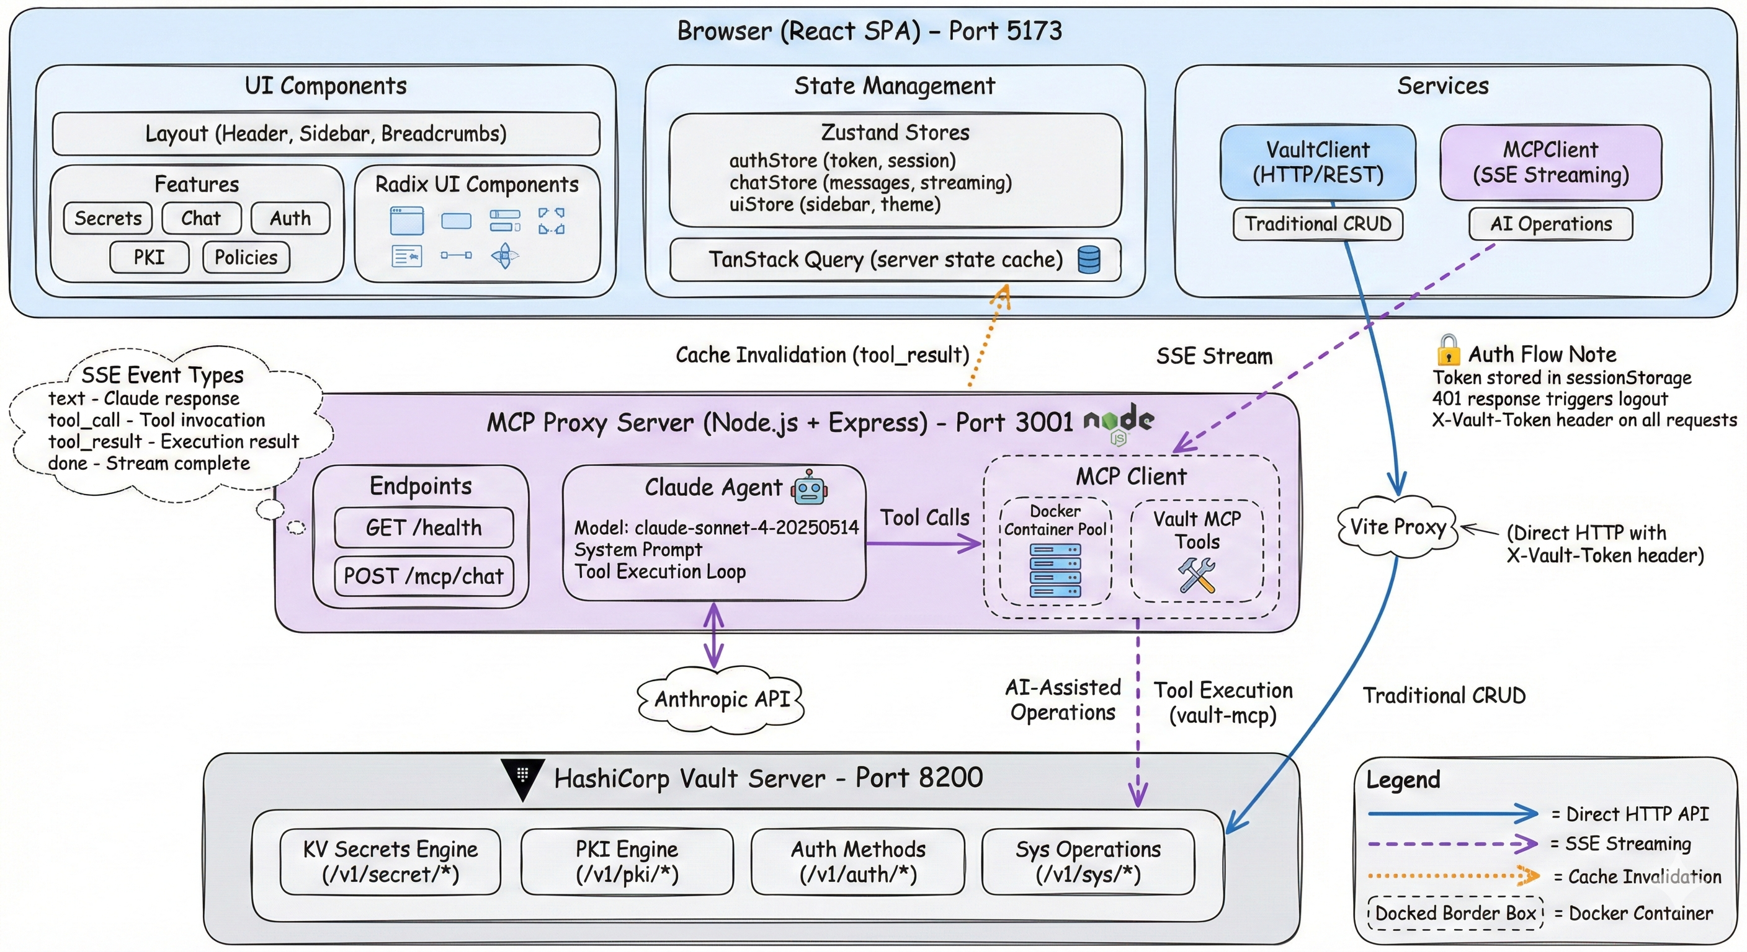
Architecture Overview – Deep Technical View
Notes:
SSE (Server-Sent Events) is a web technology for one-way streaming from server to browser over
HTTP.
In Vault AI's context:
1. Browser sends a chat message to /mcp/chat via POST
2. Server streams back multiple events as the AI responds:
- text events - chunks of Claude's response as it's generated
- tool_call events - when Claude decides to call a Vault tool
- tool_result events - results from executing those tools
- done event - signals stream completion
Why SSE instead of regular HTTP?
- Claude generates responses token-by-token - SSE lets users see text appearing in real-time
rather than waiting for the full response
- Tool calls can take time - SSE shows progress (tool started → tool finished)
- Better UX for AI chat interfaces
How it differs from WebSocket:
- SSE is simpler (one-way: server → client only)
- Works over standard HTTP (easier with proxies/firewalls)
- Browser reconnects automatically if connection drops
The MCPClient in services/mcp/client.ts reads this stream using the Fetch API's ReadableStream
and fires callbacks as events arrive.

Slide 8
Demo Environment
6 KV v2 mounts simulating typical enterprise Vault deployment
applications/ - Service secrets by environment (dev, staging, prod)
infrastructure/ - AWS, Kubernetes, Terraform, Docker, Monitoring
teams/ - Platform, Security, DevOps, Data team credentials
third-party/ - AI services, Slack, Stripe, Auth providers
60+ secrets across all mounts for realistic testing

Slide 9
Demo Scenarios with admin/root
Secret Discovery - "What secret mounts do we have?"
Reading Secrets - "Show me user-service prod database credentials"
Cross-referencing - "Which services connect to PostgreSQL?"
Creating Secrets - "Create a secret for inventory-service in dev..."
Bulk Operations - "Find all secrets related to databases"
PKI Management - "Set up internal PKI for microservices"

Slide 10
Vault AI
AI Secrets Management
Secure by Design: RBAC & Policy Enforcement

Slide 11
The Challenge
Traditional Pain Points
The Risk with AI + Secrets
Engineers struggle to find secrets across complex hierarchies
Manual navigation through nested paths is error-prone
No natural language interface for common operations
Context switching between tools slows productivity
AI assistants need guardrails
Users might accidentally access unauthorized data
Privilege escalation concerns
"AI should help users access secrets they're authorized to see—not bypass security controls"

Slide 12
Vault AI Solution Architecture
Browser (React SPA)
User authenticates with Vault token stored in sessionStorage
▼ Uses USER'S token ▼
MCP Proxy + Claude AI
Processes natural language → Vault API calls (passes through user token)
▼ X-Vault-Token header ▼
HashiCorp Vault Server
Policy enforcement at API level: Allowed → Returns secret | Denied → 403
Key Insight: AI operations inherit the user's permissions—no privilege escalation possible

Slide 13
Demo Personas - Five Enterprise Roles
Role | Team | Primary Access | Restricted From
api-developer | API Team | API Gateway, Third-party APIs | Database secrets, Infrastructure
dba-admin | Database Team | All database credentials | API keys, Cloud infrastructure
security-analyst | Security Team | Certificates, Audit (read-only) | Cannot modify anything
devops-engineer | DevOps Team | Infrastructure, CI/CD | Payment systems
platform-engineer | Platform Team | Shared configs, Notifications | Security secrets, Payments

Slide 14
Policy Example - API Developer
What They CAN Access
What They CANNOT Access
# API Gateway - full access path "applications/data/api-gateway/*" capabilities = ["create", "read", "update", "delete", "list"] # Third-party APIs path "third-party/data/ai/*" capabilities = ["read", "list"]
# Explicit denial - database path "applications/data/*/database" capabilities = ["deny"] # No infrastructure access path "infrastructure/*" capabilities = ["deny"]

Slide 15
Live Demo
api-developer
ALLOWED
Demo 1: Authorized Access
"Show me the API Gateway OAuth configuration"
Expected: Returns OAuth client_id, client_secret, endpoints
DENIED
Demo 2: Unauthorized Access
"Show me the user-service production database password"
Expected: Permission denied error from Vault
DENIED
Demo 3: Navigation Restriction
"List all secrets in the infrastructure mount"
Expected: Only sees paths they have access to

Slide 16
Live Demo
dba-admin
ALLOWED
Demo 1: Database Access
"Show me all database credentials across services"
Expected: Returns database secrets from user-service, payment-service, etc.
DENIED
Demo 2: API Key Restriction
"What's the Stripe API key for production?"
Expected: Permission denied - DBA doesn't need payment API keys
DENIED
Demo 3: Infrastructure Boundary
"Show me the AWS production credentials"
Expected: Permission denied - infrastructure secrets restricted

Slide 17
Live Demo
security-analyst
ALLOWED
Demo 1: Audit Access
"List all TLS certificates and their expiry dates"
Expected: Returns certificate information (read-only)
DENIED
Demo 2: Write Operation Blocked
"Delete the expired Snyk API token"
Expected: Permission denied - analyst has read-only access
DENIED
Demo 3: Cloud Credentials
"Show me the AWS root credentials"
Expected: Permission denied - no cloud infrastructure access

Slide 18
Technical Deep Dive - Authorization Flow
1
User logs into Vault AI with their Vault token
Token stored in browser sessionStorage only
2
User sends natural language request
"Show me the production database password"
3
MCP Proxy receives request with user's token
Forwards token in X-Vault-Token header
4
Claude determines which Vault API calls to make
GET /v1/applications/data/user-service/prod/database
5
Vault evaluates request against user's policies
Policy check: Does token have 'read' on this path?
6
Vault returns result OR 403 Forbidden
AI assistant relays result to user
No token elevation. No policy bypass. No exceptions.

Slide 19
Security Architecture Principles
Defense in Depth
What the AI Cannot Do
Browser Layer
Access secrets outside user's policy
Escalate privileges
Store or exfiltrate tokens
Bypass Vault's audit logging
Access other users' sessions
Token in sessionStorage only, cleared on close
Transport Layer
HTTPS only, no token in URLs
MCP Proxy Layer
Stateless, no token storage, pass-through only
Vault Layer
Policy enforcement, audit logging, token TTL

Slide 20
Audit & Compliance
Every AI Operation is Logged
Complete Traceability
{ "type": "request", "auth": { "policies": ["api-developer"], "metadata": { "username": "api-developer" } }, "request": { "path": "applications/...", "operation": "read" }, "response": { "status": 403 } }
Who accessed what
When they accessed it
Whether it succeeded or failed
Which policy was applied
Full request/response details
Same audit trail as direct API access

Slide 21
Enterprise Benefits
For Security Teams
For Development Teams
For Compliance
AI doesn't bypass existing Vault policies
Same audit trail as direct API access
No new attack surface introduced
Existing security controls respected
Natural language access to authorized secrets
Faster onboarding - ask instead of navigate
Reduced friction while maintaining security
Context-aware assistance
Role-based access control enforced
Audit logs capture all AI operations
Token TTL limits exposure window
Full traceability for auditors

Slide 22
Summary
Vault AI: Secure AI-Assisted Secrets Management
✓
Natural Language Interface - Ask for secrets in plain English
✓
Full Audit Trail - Every operation logged in Vault
✓
Policy Enforcement - AI inherits user's exact permissions
✓
Session Isolation - Tokens scoped to browser session
✓
✓
✓
✓
No Privilege Escalation - Token-based auth, no shortcuts
Full Audit Trail - Every operation logged in Vault
Session Isolation - Tokens scoped to browser session
Enterprise Ready - Built for production environments

Slide 23
Quick Reference - Token Regeneration
Regenerate Single Token
Demo Credentials
# Set Vault address export VAULT_ADDR=http://localhost:8200 # Get new token vault write -field=token \ auth/userpass/login/api-developer \ password=demo-password-123
Username | Password
api-developer | demo-password-123
dba-admin | demo-password-123
security-analyst | demo-password-123
devops-engineer | demo-password-123
platform-engineer | demo-password-123
Regenerate All Tokens
./scripts/setup-demo-users.sh cat scripts/demo-tokens.env

Slide 24
Traditional vs AI-Assisted Comparison
Traditional: 6 CLI commands to find a secret | Vault AI: 1 natural language query
Business Objective | CY20 Strategic Initiative (Exec Sponsor) | Risk Detail
E-commerce upgrade live on Sept 15th. Expected to contribute $2M in additional revenue | Cloud migration (CIO) | Eight week best case application delivery cycle time is too slow to support cloud migration and microservice delivery goals (300 apps/services released by September)
 | Application modernization (VP of Operations)
 | Improve security posture (CISO) | Leakage of secrets during provisioning creates breach risk
"Show me the user-service production database credentials" - That's it!

Slide 25
Security Considerations
User's Vault token required for all operations - AI has no independent access
AI operations respect Vault ACL policies - cannot exceed user permissions
Secret values never logged or sent to AI training
All operations logged in Vault audit log for compliance
Tokens stored in sessionStorage only - cleared on browser close

Slide 26
Roadmap & Next Steps
Current: KV v2, PKI, Mount Management - fully supported
Next: Transit Engine - Encryption as a Service
Planned: Database Secrets Engine - dynamic credentials
Future: AWS/Cloud Dynamic Credentials
Questions?

